Slide 1
Azure SQL and Open AI using T-SQL
Dennes Torres
dennes@bufaloinfo.com.br

Slide 2
Sponsors & Organizers

Slide 3







Dennes Torres Data Platform MVP (Alumni)
Dtower Software & Onyx Data
https://dtowersoftware.com
Trainer
MCT, Azure Solutions Architect, Azure Data Engineer and Azure DevOps Engineer
Malta Data Platform UG Leader
Malta
MMDPUG
https://www.facebook.com/MMDPUG
http://dennestorres.com
Dennes.Torres
@Dennes
https://br.linkedin.com/in/dennestorres
dennes@bufaloinfo.com.br
http://youtube.com/c/dennestorres

Slide 4
Vector Search Practical Approach

Slide 5
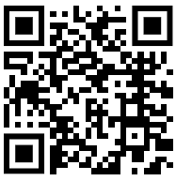
Reference

Slide 6
sp_invoke_external_rest_endpoint
External API calls from T-SQL
Requires a Credential Object
Can call Azure Open AI Service
Can call for embeddings or GPT
Only call Azure URLs
Outside Azure URLs can use APIM

Slide 7
Credential
create database scoped credential [https://aiopentraining.openai.azure.com/]
with identity = 'HTTPEndpointHeaders’,
secret = '{"api-key": “<<Your API Key>>"}';
go

Slide 8
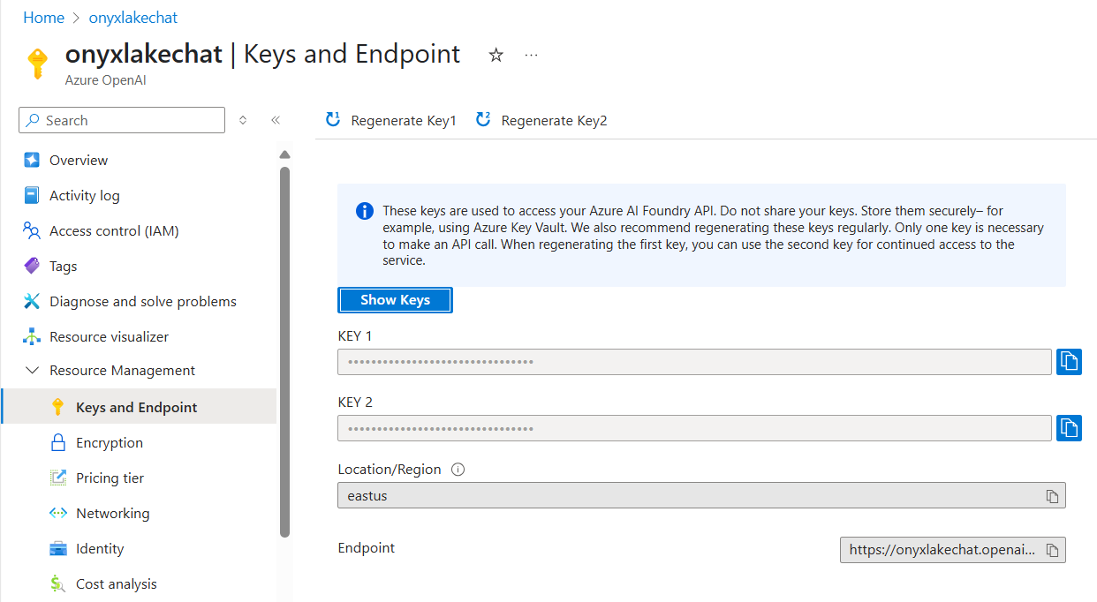

Slide 9
sp_invoke_external_rest_endpoint syntax
exec @retval = sp_invoke_external_rest_endpoint
@url = @url,
@method = 'POST',
@credential = [https://aiopentraining.openai.azure.com/],
@payload = @payload,
@response = @response output;

Slide 10
Let’s create a better product description using OpenAI

Slide 11
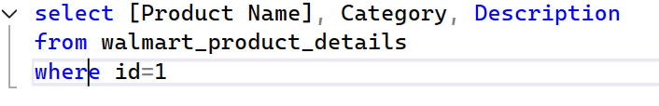
We aim to show you accurate product information. Manufacturers, suppliers and others provide what you see here, and we have not verified it. See our disclaimer |La Costena Chipotle Peppers, 7 OZ (Pack of 12) Easy open. Ready to serve! Product of Mexico.

Slide 12
Product in JSON Format

Slide 13
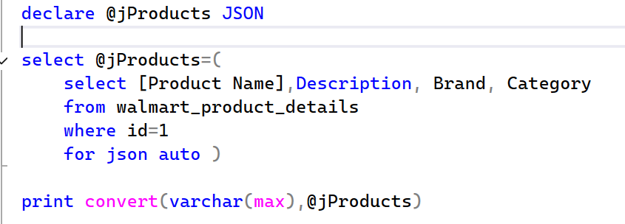
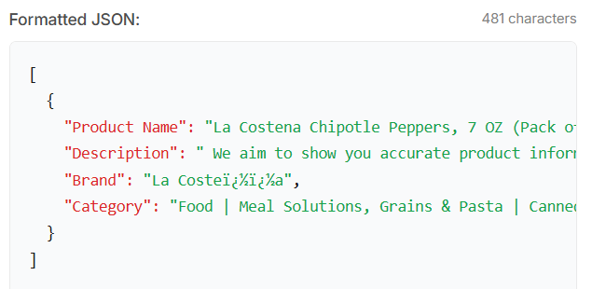

Slide 14
System Message

Slide 15
You are a marketing specialist and your work is to improve
the information provided about the products to make them more
attractive to consumers.
You will receive information in JSON and it's imperative
that your entire response is provided as a JSON object

Slide 16
JSON Payload

Slide 17
{ "messages”:
[
{“role": “system,
“content":""},
{“role":“user",
“content":""}
]
}

Slide 18
Payload Messages

Slide 19
JSON_OBJECT(‘role' : ‘system', ‘content' : '')
JSON_OBJECT(‘role' : ‘system', ‘content' : '')

Slide 20
Message Object

Slide 21
JSON_OBJECT('messages',
JSON_ARRAY(
JSON_OBJECT('role' : 'system', 'content' : ''),
JSON_OBJECT('role' : 'system', 'content' : '')
)
)

Slide 22
Adding the System Message

Slide 23
JSON_OBJECT('messages',
JSON_ARRAY(
JSON_OBJECT('role' : 'system', 'content' :
'You are a marketing specialist and your work is to
improve the information provided about the products to
make them more attractive to consumers.
You will receive information in JSON and it''s
imperative that your entire response is
provided as a JSON object'),
JSON_OBJECT('role' : 'user', 'content' : ‘’)
)
)

Slide 24
User Message in the Payload

Slide 25
declare @jProducts JSON
declare @llm_payload nvarchar(max);
select @jProducts=(
select [Product Name],Description, Brand, Category
from walmart_product_details
where id=1
for json auto )
set @llm_payload=JSON_OBJECT('messages':
JSON_ARRAY(
JSON_OBJECT('role' : 'system', 'content' :
'You are a marketing specialist and your work is to
improve the information provided about the products to
make them more attractive to consumers.
You will receive information in JSON and it''s
imperative that your entire response is
provided as a JSON object'),
JSON_OBJECT('role' : 'system',
'Content' : 'Using the information of the product located below,
could you provide a beter description for the product,
a description more attractive to the consumers ?
'
+ convert(varchar(max),@jProducts)
)
)
)

Slide 26
Building the URL for the Call

Slide 27
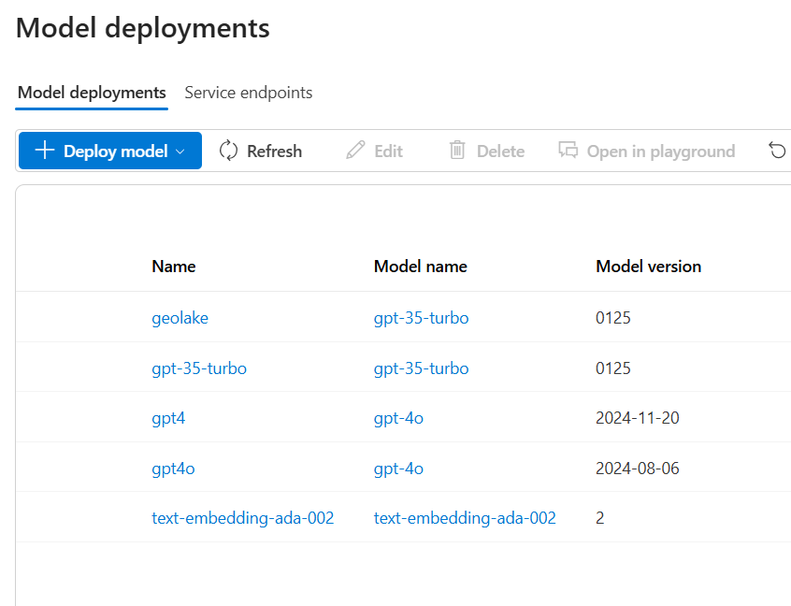

Slide 28
declare @deployedModelName nvarchar(1000) ='geolake'
declare @url nvarchar(max)=
'https://onyxlakechat.openai.azure.com/openai/deployments/'
+ @deployedModelName +
'/chat/completions?api-version=2024-08-01-preview' -- Completions API

Slide 29
Complete Call

Slide 30
;
declare @llm_payload nvarchar(max);
declare @jProducts JSON
declare @deployedModelName nvarchar(1000)='geolake'
declare @url nvarchar(max)=
'https://onyxlakechat.openai.azure.com/openai/deployments/'
+ @deployedModelName +
'/chat/completions?api-version=2024-08-01-preview' -- Completions API
declare @retval int
declare @response nvarchar(max);
select @jProducts=(
select [Product Name],Description, Brand, Category
from walmart_product_details
where id=1
for json auto )
set @llm_payload=json_object('messages':
json_array(
json_object('role' : 'system', 'content' :
'You are a marketing specialist and your work is to
improve the information provided about the products to
make them more attractive to consumers.
You will receive information in JSON and it''s
imperative that your entire response is
provided as a JSON object'),
json_object('role' : 'user',
'content' : 'Using the information of the product located below,
could you provide a beter description for the product,
a description more attractive to the consumers ?
'
+ convert(varchar(max),@jProducts) )
)
)
exec @retval = sp_invoke_external_rest_endpoint
@url = @url,
@headers = '{"Content-Type":"application/json"}',
@method = 'POST',
@credential = [https://onyxlakechat.openai.azure.com/],
@timeout = 120,
@payload = @llm_payload,
@response = @response output;
print(@response)

Slide 31
Complete Code

Slide 32
Process Result

Slide 33
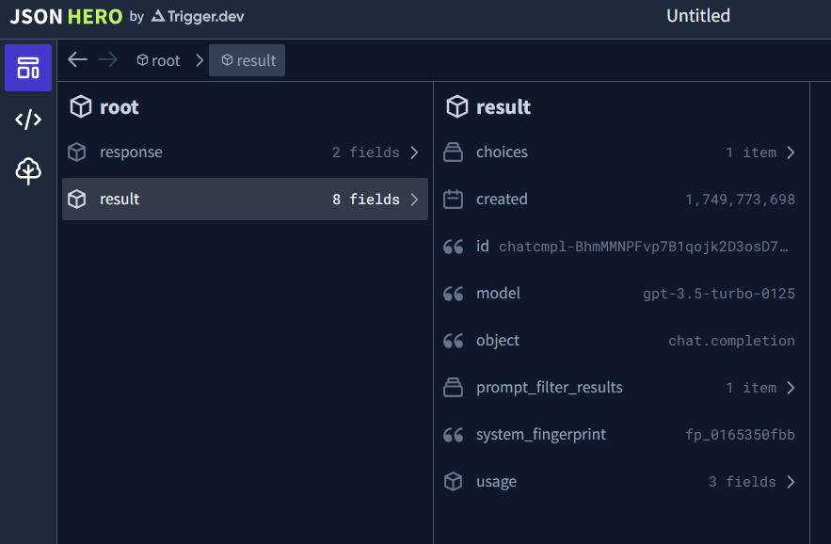
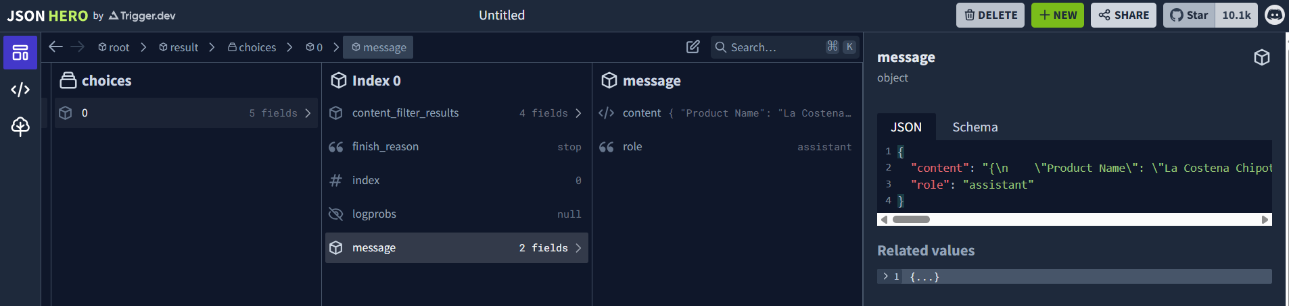

Slide 34
select t.[value]
from openjson(@response, '$.result.choices') c cross apply openjson(c.value, '$.message') t
where t.[key]='content'

Slide 35
Experience the authentic flavors of Mexico with La Costeña Chipotle Peppers. Each can contains 7 ounces of smoky and spicy chipotle peppers, ready to add a bold kick to your favorite dishes. These peppers are easy to open and ready to serve, making meal prep a breeze. Bring the taste of Mexico to your kitchen with La Costeña Chipotle Peppers!

Slide 36
Processing the Response

Slide 37
Dennes Torres Data Platform MVP (Alumni)
Dtower Software & Onyx Data
https://dtowersoftware.com
Trainer
MCT, Azure Solutions Architect, Azure Data Engineer and Azure DevOps Engineer
Malta Data Platform UG Leader
Malta
MMDPUG
https://www.facebook.com/MMDPUG
http://dennestorres.com
Dennes.Torres
@Dennes
https://br.linkedin.com/in/dennestorres
dennes@bufaloinfo.com.br
http://youtube.com/c/dennestorres

